Slide 1
ADVERSARIAL ATTACKS & DEFENCES ON PHISHING DETECTION MODELS
Prepared by : Archana Sreekumar (AM.EN.P2CSN18005)
Mentored by : Dr Krishnashree Achuthan
Collaborator : Mr Gilad Gressel, Georgia Tech, USA

Slide 2
OVERVIEW
What is phishing?
Adversarial attack on ML model
Problem statement
Dataset used
Basic architecture
Method of feature selection
Training & testing using dataset
Modification & testing on dataset
Observations
Adversarial training
Roadmap until next review
Conclusion

Slide 3

What is Phishing?
“Phishing is the act of tricking people into
entering their sensitive information by
disguising oneself as a trustworthy entity”
Source: https://whatismyipaddress.com/phishing

Slide 4

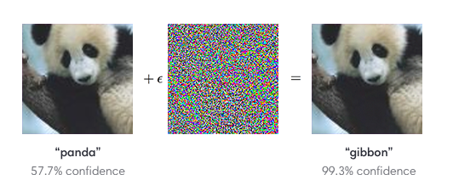
Adversarial Attacks on ML Model
“An adversary crafts a malicious input sample with the intention of causing the machine learning model to make an incorrect prediction”
Source: Explaining and Harnessing Adversarial Examples, Goodfellow et al.[5]

Slide 5
Problem Statement
“To learn whether phishing detection models are vulnerable to adversarial
attacks and to defend the model against such adversarial attacks.”
Carefully crafted adversarial examples could evade phishing detection models.
Millions of user accounts could be compromised through the misclassification of phishing detection models under adversarial attack.

Slide 6
Adversarial Attacks on Phishing Detection Model
Normal Condition
Prediction
Classifier
Model
Classifier
Model
Phish
Phish
Legitimate
Legitimate
Under Adversarial Attack
Prediction
Classifier
Model
Classifier
Model
Phish
Legitimate
Legitimate
Legitimate/ Phish

Slide 7
Closely Related Work

Slide 8
Adversarial Sampling Attack Against Phishing Detection
Demonstrate attack on phishing detection models
Dataset consist of a number of features for each instance and corresponding label.
‘-1’ indicates a legitimate page and ‘1’ indicates phishing page.
Different combinations of features are considered.
Original phishing instance and selected features used to create adversarial sample.
H. Shirazi, B. Bezawada, I. Ray, and C. Anderson. "Adversarial Sampling Attacks Against Phishing Detection." IFIP Annual Conference on Data and Applications Security and Privacy. Springer, Cham, 2019. #citations – 0,Google h5 index - NA

Slide 9
Work Done

Slide 10
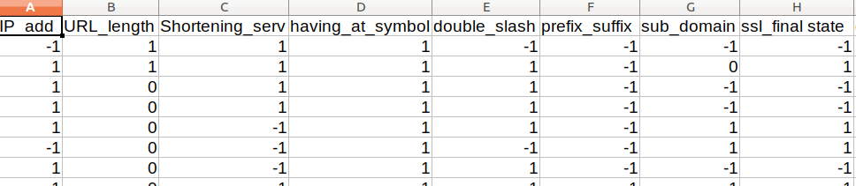

Dataset Used
Phishing dataset from UCI Machine learning repository
  Dataset 1 [2]
    Number of attributes: 30
    Number of instances: 2456
    Attribute characteristics: Integer
  Dataset 2 [3]
    Number of attributes: 10
    Number of instances: 1353
    Attribute characteristics: Integer
Dheeru Dua and Casey Graff. UCI Machine Learning Repository. 2017. url : http://archive.ics.uci.edu/ml

Slide 11
Basic Architecture
Training phase:
Training phase:
Classifier
Model
Classifier
Model
X – input data
y – output
X,y
X,y
Test phase:
X – input data without modification
X’ – attack data
y,y’ – prediction
X
Classifier
Model
y
X’
y’

Slide 12
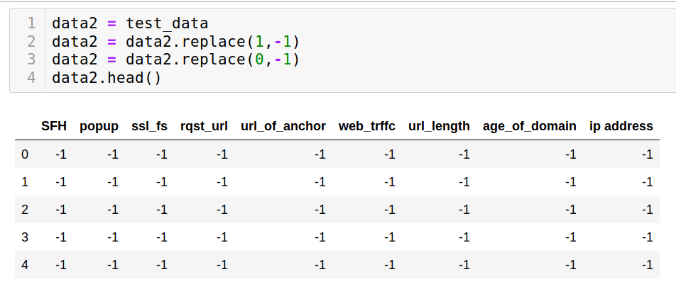
Method of Feature Selection
Label 1 indicates phishing instance & -1 indicates legitimate instance
Feature values -1 is biased towards legitimate instance & 1 towards phishing instance
Take a set of phishing instances
Replace all feature values with -1 which indicates a ‘legitimate’ value and check prediction
Change the value of each feature sequentially to 1 and check the prediction by the model
Select those features which upon changing to 1 caused a change in prediction to -1.

Slide 13
Training & Testing Using Same Data
Model is trained using phishing and legitimate instances in the dataset
Testing is done using the same phishing instances in the dataset with and without modification
Accuracy: Before modification – DS1:96%, DS2:92%. After modification – DS1:14%, DS2:0%
Training
Testing
Classifier
Model
Classifier
Model
Dataset
(leg+phish)
Phish
y
Modified
Phish
y’

Slide 14
Training & Testing Using Different Data
From the dataset 200 phishing instances are separated out
Model is trained using the remaining dataset
Testing is done using the 200 phishing instances with and without modification
Accuracy: Before modification – DS1:96.5%, DS2:82%. After modification – DS1:9.5%, DS2:0%
Training
Testing
Classifier
Model
Classifier
Model
Dataset - 200
(leg+phish)
Phish(200)
y
Modified
Phish(200)
y’

Slide 15
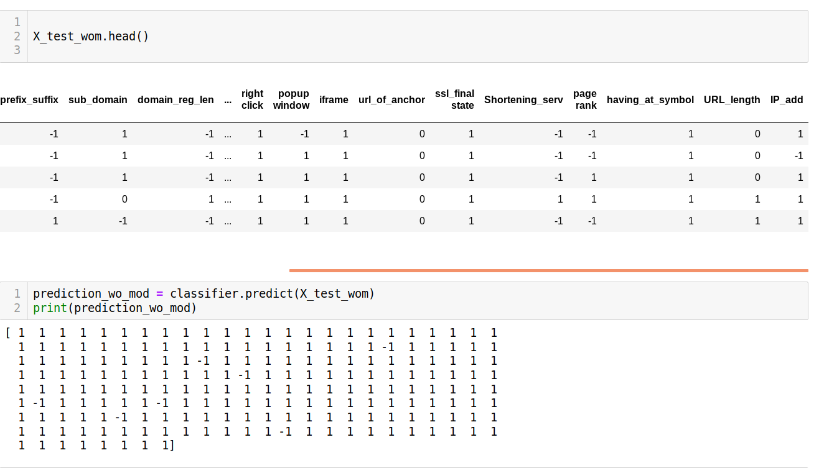
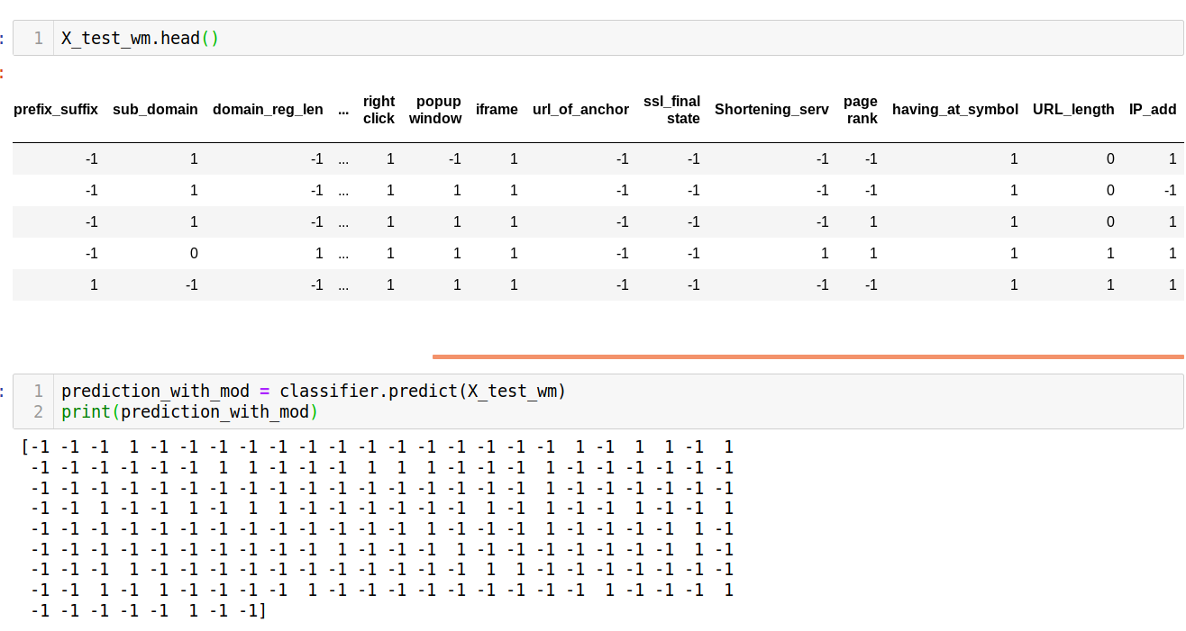
Modification & Testing on Dataset 1
Result ‘1’ indicate phishing instance & ‘-1’ indicates legitimate instance
Result before feature modification Result after feature modification
Most values
are 1
Most values
are -1

Slide 16
Observations – Dataset 1
Train Data | Test Data | Accuracy before modification (%) | Accuracy after modification (%)
Complete dataset | all phish | 96 | 14
Without 200 phish | 200 phish | 96.5 | 9.5

Slide 17
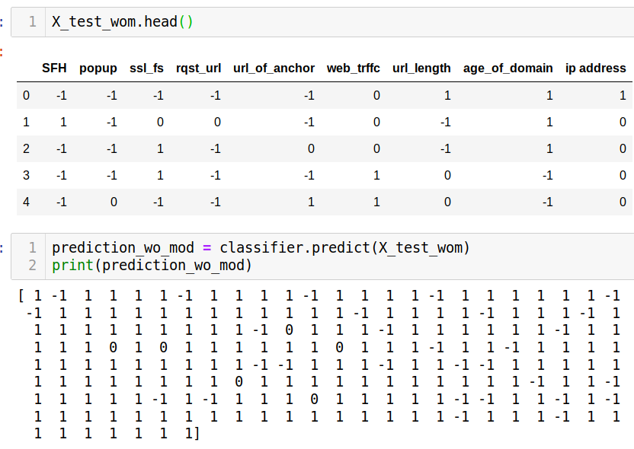
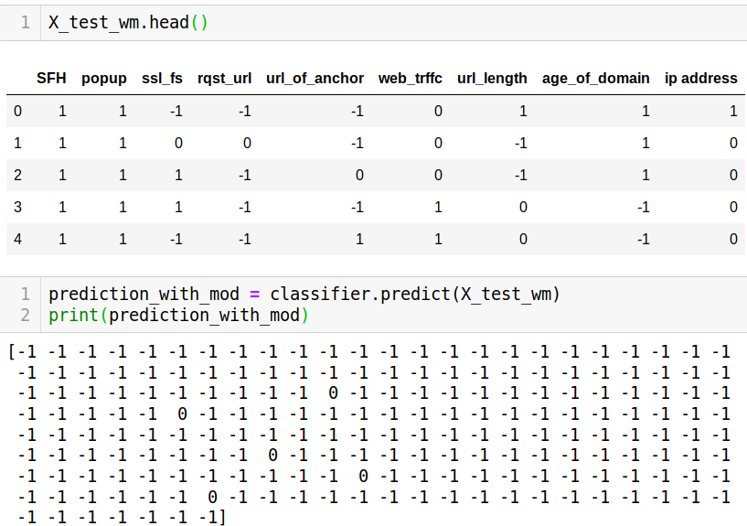
Modification & Testing on Dataset 2
Feature values 1 for legitimate & -1 for phish
Result before feature modification Result after feature modification

Slide 18
Observations – Dataset 2
Train Data | Test Data | Accuracy before modification (%) | Accuracy after modification (%)
Complete dataset | all phish | 92 | 0
Without 200 phish | 200 phish | 82 | 0

Slide 19
Adversarial Training
Intentionally inject adversarial samples to the training dataset.
Train the model to classify these samples to the correct class.
Makes the model more robust.
Here the model is trained along with modified phishing instances.
Model is tested using different set of modified phishing instances and the accuracy is checked.

Slide 20
Observations
Dataset | Test Data | Accuracy before adv training (%) | Accuracy after adv training (%)
1 | Modified phish | 9.5 | 45
2 | Modified phish | 0 | 54

Slide 21
Roadmap Until Next Review
Construct the attack on real valued dataset.
Check whether the functionality of the web page is maintained.
Construct a robust defence mechanism against such attacks.

Slide 22
Conclusion
Adversarial attacks represent a concrete problem in the field of machine learning.
The vulnerability of phishing detection models to adversarial attacks could lead to exposure of sensitive information of millions of users.
There is a need for finding a method to craft an adversarial example which scales inorder to find out the possible vulnerabilities of the model and also to define a robust defence mechanism.

Slide 23
References
[1] H. Shirazi, B. Bezawada, I. Ray, and C. Anderson, “Adversarial Sampling Attacks Against Phishing Detection,”
Data and Applications Security and Privacy XXXIII Lecture Notes in Computer Science, pp. 83–101, 2019.
[2] Abdelhamid et al.,(2014a) Phishing Detection based Associative Classification Data Mining. Expert Systems With Applications (ESWA), 41 (2014) 5948â€“5959.
[3] Rami M Mohammad, Fadi Thabtah, and Lee McCluskey. “An assessment of features related to phishing websites
using an automated technique”. In: 2012 International Conference for Internet Technology and Secured Transactions. IEEE. 2012, pp. 492–497.
[4] H. Shirazi, B. Bezawada, I. Ray, and C. Anderson, “Adversarial Sampling Attacks Against Phishing Detection,”
Data and Applications Security and Privacy XXXIII Lecture Notes in Computer Science, pp. 83–101, 2019.
[5] I. Goodfellow, J. Shlens, and C. Szegedy, “Explaining and Harnessing Adversarial Examples,” Google AI, 01-Jan-1970. [Online]. Available: https://ai.google/research/pubs/pub43405. [Accessed: 21-Sep-2019].

Slide 24
Thank You

